Slide 1

Events and Listeners
ActionListener
KeyListener
MouseListener
Handling Scope
Converter Example

Slide 2

See Also
http://www.tutorialspoint.com/swing/swing_event_listeners.htm
https://docs.oracle.com/javase/tutorial/uiswing/events/intro.html
Notes:
Some additional information on concurrency

Slide 3
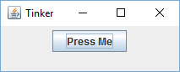
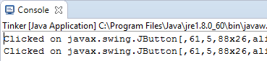
Action Listener
class ButtonPress implements ActionListener {
@Override
public void actionPerformed(ActionEvent evt) {
System.out.println("Clicked on "+evt.getSource());
}
}
public class Tinker {
public static void main(String [] args) {
JPanel pan = new JPanel();
JButton bt = new JButton("Press Me");
pan.add(bt);
ButtonPress handler = new ButtonPress();
bt.addActionListener(handler);
JFrame jf = new JFrame("Tinker");
jf.setContentPane(pan);
jf.setDefaultCloseOperation(JFrame.DISPOSE_ON_CLOSE);
jf.setSize(320, 240);
jf.setVisible(true);
}
}

Slide 4
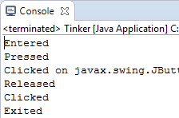
Mouse Listener
class MouseStuff implements MouseListener {
@Override
public void mouseClicked(MouseEvent evt) {
System.out.println("Clicked");
}
@Override
public void mouseEntered(MouseEvent evt) {
System.out.println("Entered");
}
@Override
public void mouseExited(MouseEvent evt) {
System.out.println("Exited");
}
@Override
public void mousePressed(MouseEvent evt) {
System.out.println("Pressed");
}
@Override
public void mouseReleased(MouseEvent evt) {
System.out.println("Released");
}
}
ButtonPress handler = new ButtonPress();
bt.addActionListener(handler);
bt.addMouseListener(new MouseStuff());

Slide 5
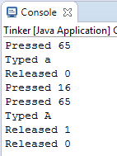
Key Listener
class Keys implements KeyListener {
@Override
public void keyPressed(KeyEvent evt) {
System.out.println("Pressed "+evt.getKeyCode());
}
@Override
public void keyReleased(KeyEvent evt) {
System.out.println("Released "+evt.getModifiers());
}
@Override
public void keyTyped(KeyEvent evt) {
System.out.println("Typed "+evt.getKeyChar());
}
}
bt.addKeyListener(new Keys());

Slide 6
Listeners in Action
https://docs.oracle.com/javase/tutorial/uiswing/components/
JButton, JCheckBox, JRadioButton, JComboBox – ActionListener
JTextField – ActionListener (pressing ‘enter’)
You can add multiple listeners to one component
You can add the same listener to multiple components

Slide 7
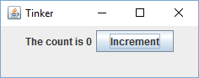
Scope
public class Tinker {
public static void main(String [] args) {
int count = 0;
JLabel countText = new JLabel("The count is "+count);
JButton bump = new JButton("Increment");
BumpCount handler = new BumpCount();
bump.addActionListener(handler);
JPanel pan = new JPanel();
pan.add(countText);
pan.add(bump);
JFrame jf = new JFrame("Tinker");
jf.setContentPane(pan);
jf.setDefaultCloseOperation(JFrame.DISPOSE_ON_CLOSE);
jf.setSize(250, 100);
jf.setVisible(true);
}
}
class BumpCount implements ActionListener {
@Override
public void actionPerformed(ActionEvent arg0) {
count = count + 1;
countText.setText("The count is "+count);
}
}

Slide 8

Scope Solutions
How do we share pointers between two objects?
Not with local variables
Static variables
Pass around multiple pointers
Pass around one pointer to an object with accessible pointers
Inner classes help with the syntax
Java 8 Lambdas help even more
Bad: only one copy
Bad: tedious

Slide 9

public class BumpCounter {
private int count = 0;
private JLabel countText = new JLabel("The count is "+count);
private JButton bump = new JButton("Increment");
class BumpCount implements ActionListener {
@Override
public void actionPerformed(ActionEvent arg0) {
count = count + 1;
countText.setText("The count is "+count);
}
}
public JPanel getPanel() {
BumpCount handler = new BumpCount();
bump.addActionListener(handler);
JPanel pan = new JPanel();
pan.add(countText);
pan.add(bump);
return pan;
}
}
public static void main(String [] args) {
BumpCounter cnt = new BumpCounter();
JFrame jf = new JFrame("Tinker");
jf.setContentPane( cnt.getPanel() );
jf.setDefaultCloseOperation(JFrame.DISPOSE_ON_CLOSE);
jf.setSize(250, 100);
jf.setVisible(true);
}

Slide 10

public class BumpCounter {
private int count = 0;
private JLabel countText = new JLabel("The count is "+count);
private JButton bump = new JButton("Increment");
public JPanel getPanel() {
bump.addActionListener(new ActionListener() {
@Override
public void actionPerformed(ActionEvent e) {
count = count + 1;
countText.setText("The count is "+count);
}
});
JPanel pan = new JPanel();
pan.add(countText);
pan.add(bump);
return pan;
}
}

Slide 11
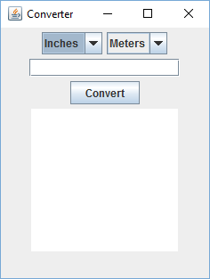
Converter GUI
public class ConverterGUI {
private JComboBox<String> from;
private JComboBox<String> to;
private JTextField value;
private JTextArea history;
private JButton convert;
public ConverterGUI() {
from = new JComboBox<String>();
from.addItem("Inches");
from.addItem("Meters");
from.setSelectedIndex(0);
to = new JComboBox<String>();
to.addItem("Inches");
to.addItem("Meters");
to.setSelectedIndex(1);
value = new JTextField(15);
history = new JTextArea(10,15);
convert = new JButton("Convert");
}
}
public static void main(String[] args) {
ConverterGUI converter = new ConverterGUI();
JFrame jf = new JFrame("Converter");
jf.setContentPane(converter.getPanel());
jf.setDefaultCloseOperation(JFrame.DISPOSE_ON_CLOSE);
jf.setSize(250,320);
jf.setVisible(true);
}
public JPanel getPanel() {
JPanel pan = new JPanel();
pan.add(from);
pan.add(to);
pan.add(value);
pan.add(convert);
pan.add(history);
return pan;
}

Slide 12
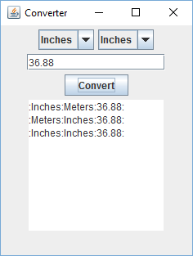
Converter Events (Inner)
public class ConverterGUI {
private JComboBox<String> from;
private JComboBox<String> to;
private JTextField value;
private JTextArea history;
private JButton convert;
class ConvertHandler implements ActionListener {
@Override
public void actionPerformed(ActionEvent e) {
String fromUnits = (String)from.getSelectedItem();
String toUnits = (String)to.getSelectedItem();
String valueString = value.getText();
String resultString = ":"+fromUnits+":"+toUnits+":"+valueString+":";
history.append(resultString+"\n");
}
}
public ConverterGUI() {
convert = new JButton("Convert");
convert.addActionListener(new ConvertHandler());
}
}

Slide 13
Converter Events (Anonymous)
public ConverterGUI() {
convert = new JButton("Convert");
convert.addActionListener(new ActionListener() {
@Override
public void actionPerformed(ActionEvent e) {
String fromUnits = (String)from.getSelectedItem();
String toUnits = (String)to.getSelectedItem();
String valueString = value.getText();
String resultString = ":"+fromUnits+":"+toUnits+":"+valueString+":";
history.append(resultString+"\n");
}
});
}

Slide 14

Tinkering
Finish the Converter application!
Make a Swing application for the “Hi-Lo” game.
Show the player the current guess number and the highest score so far.
Add a button to “Start Over”.
Add a button to “Clear High Score”.
Add a text field for the game’s “highest number”.

